Slide 1


Department of BES-1
Data STRuctures through
python
24SC1204
Topic:
Minimum Spanning Tree - Kruskal’s Algorithm
Session - 39

Slide 2



AIM OF THE SESSION
To familiarize students with the basic concept of Kruskal’s Algorithm
INSTRUCTIONAL OBJECTIVES
This Session is designed to:
Demonstrate Kruskal’s Algorithm
Describe Minimum Spanning Tree
LEARNING OUTCOMES
At the end of this session, you should be able to:
Define Minimum Spanning Tree
Summarize Kruskal’s Algorithm

Slide 3
SESSION INTRODUCTION
A minimum spanning tree (MST) is a subset of the edges of a connected, edge-weighted graph that connects all the vertices together without any cycles and with the minimum possible total edge weight. It is a way of finding the most economical way to connect a set of vertices.
A minimum spanning tree is not necessarily unique. All the weights of the edges in the MST must be distinct. If all the weights of the edges in the graph are the same, then any spanning tree of the graph is an MST.
The edges of the minimum spanning tree can be found using the greedy algorithm or the more sophisticated Kruskal or Prim's algorithm..
It is a spanning tree whose sum of edge weights is as small as possible.

Slide 4
SESSION DESCRIPTION
Kruskal’s Algorithm is a famous greedy algorithm.
It is used for finding the Minimum Spanning Tree (MST) of a given graph.
To apply Kruskal’s algorithm, the given graph must be weighted, connected and undirected.
Kruskal’s Algorithm builds the spanning tree by adding edges one by one into a growing spanning tree.
In each iteration it finds an edge which has least weight and adds it to the growing spanning tree.

Slide 5
SESSION DESCRIPTION (Cont..)
1. Sort all the edges in non-decreasing order of their weight.
2. Pick the smallest edge. Check if it forms a cycle with the spanning tree formed so far. If cycle is not formed, include this edge. Else, discard it.
3. Repeat step#2 until there are (V-1) edges in the spanning tree.

Slide 6
ACTIVITIES/ CASE STUDIES/ IMPORTANT FACTS RELATED TO THE SESSION
Network design
Traveling salesperson problem

Slide 7
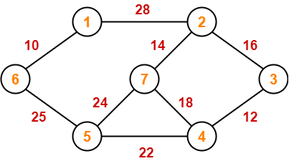
EXAMPLES
The algorithm is a Greedy Algorithm.
The Greedy Choice is to pick the smallest weight edge that does not cause a cycle in the MST constructed so far.
Consider the below input graph.
The graph contains 9 vertices and 14 edges. So, the minimum spanning tree formed will have (9 – 1) = 8 edges.

Slide 8
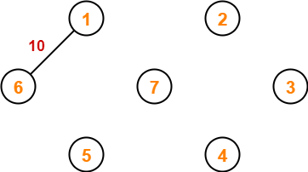
Step 1: Now pick all edges one by one from sorted list of edges
1. Pick edge 6-1: No cycle is formed, include it.
After sorting:
Weight Src Dest
10 6 1
12 4 3
14 2 7
16 2 3
18 5 4
22 8 6
24 5 7
25 6 5
28 1 2

Slide 9
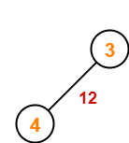
step 3: Now pick edge 4-12. No cycle is formed, hence include it.

Slide 10
step 3: Now pick edge 4-12. No cycle is formed, hence include it.

Slide 11
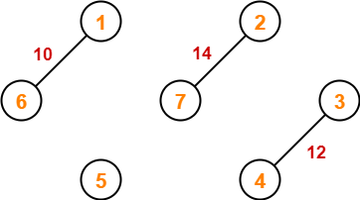
Step 4: Now pick edge 7-2. No cycle is formed, include it.

Slide 12
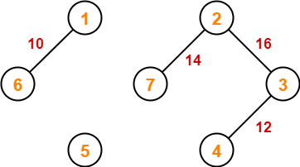
Step 5: Now pick edge 2-3. No cycle is formed, so include it.

Slide 13
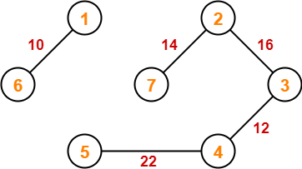
Step 6: Now pick edge 5-4. No cycle is formed, so include it.

Slide 14
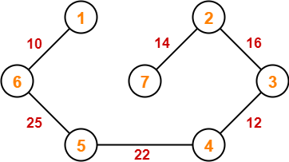
Step 7:Now pick edge 6-5. No cycle is formed, so include it.
Since all the vertices have been connected / included in the MST, so we stop.
Weight of the MST = Sum of all edge weights= 10 + 25 + 22 + 12 + 16 + 14
= 99 units

Slide 15
SUMMARY
We find minimum spanning tree using kruskal’s algorithm by including edges with minimum cost.
First we have to sort vertices from minimum edge cost to maximum edge cost. Then we have to include vertices in such a way that no closed loops occur and all vertices are included exactly once.

Slide 16
SELF-ASSESSMENT QUESTIONS
Kruskal’s algorithm is a ______
a) divide and conquer algorithm
b) dynamic programming algorithm
c) greedy algorithm
d) approximation algorithm
What is the time complexity of Kruskal’s algorithm?
a) O(log V)
b) O(E log V)
c) O(E2)
d) O(V log E)

Slide 17
TERMINAL QUESTIONS
1. Find minimum spanning tree for the following weighted graph using Kruskal's Algorithm. List out at least four real time applications where kruskal’s algorithm is applicable?
2. Write kruskal’s algorithm to find minimum spanning tree of the graph and analyze its time complexity with adjacency matrix and list representation?
3. Write an algorithm to implement kruskal’s algorithm to find minimum spanning tree of the given undirected graph?

Slide 18
REFERENCES FOR FURTHER LEARNING OF THE SESSION
TEXTBOOKS:
1. Mark Allen Weiss, Data Structures and Algorithm Analysis in C, 2010, Second Edition, Pearson Education.
2. Allen B. Downey, ”Think Python: How to Think Like a Computer Scientist’’, 2nd edition, Updated for Python 3, Shroff/O’Reilly Publishers, 2016 (http://greenteapress.com/wp/thinkpython/)
3. Data Structures and algorithms using python, 2011,Rance D, Necaise, himilton printing
REFERENCE BOOKS:
1. Data Structures and Algorithm Analysis in PYTHON, 2010, Mark Allen Weiss, Second Edition, Pearson Education.
2. Data Structures and Algorithms, A.V.Aho, J.E.Hopcroft, and J.D.Ullman, Pearson Education, First Edition Reprint2003.
3. Advanced Guide to Python 3 Programming, John Hunt, 4th Edition, Springer Nature Switzerland AG 2019.
4. Python Basics: A Practice Introduction to Python 3, David Amos, Dan Bader, Joanna Jablonski, Fletcher Heisler, 4th edition, Real Python..
WEB REFERNCES/MOOCS:
1. https://docs.python.org/3/tutorial/datastructures.html
2. https://www.w3schools.com/dsa/dsa_intro.php
3. https://www.geeksforgeeks.org/python-data-structures/

Slide 19
THANK YOU
Team – Data Structures through Python

